Slide 1

Rockbuster Stealth Analysis
Maya Kirkby

Slide 2
Goals
To examine the data from previous sales throughout the years
To determine the best path forward based on our findings

Slide 3
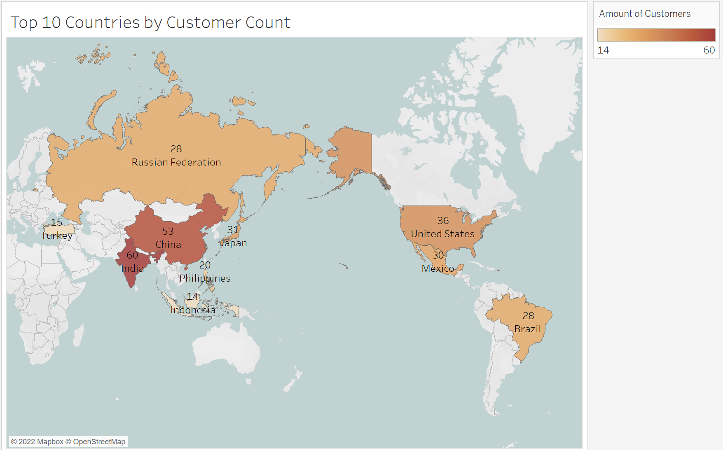
Where is most of our business located?
Most of our business lies in Asia. India, China and Japan have the most customers
The United States and Mexico also have many customers compared to other regions of the world

Slide 4
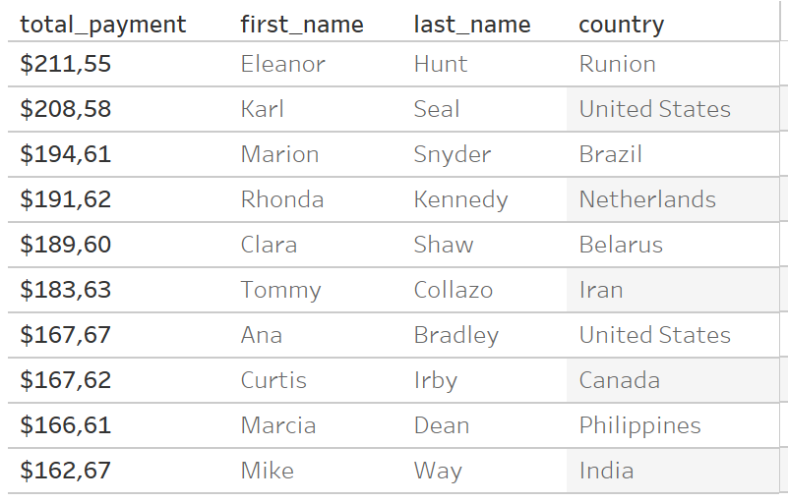
Who are our customers?
Our highest-paying customers are spread out all around the globe, with no one region standing out
The countries with the top 3 highest paying customers are Runion, Untied States, and Brazil.

Slide 5
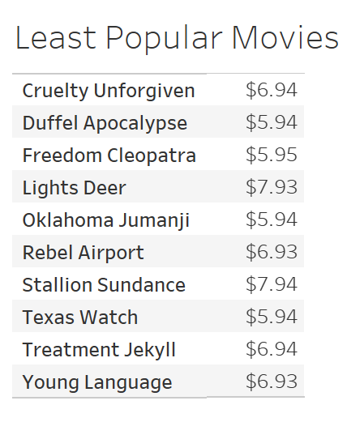
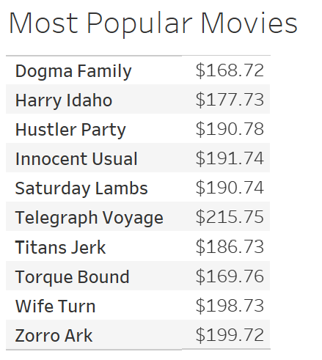
Revenue
These are the movies that generated the most and least amount of revenue
On average, movies are rented for 5 days
The least popular movies are rented for an average of 6 days
The most popular movies are rented for an average of 3.5 days

Slide 6
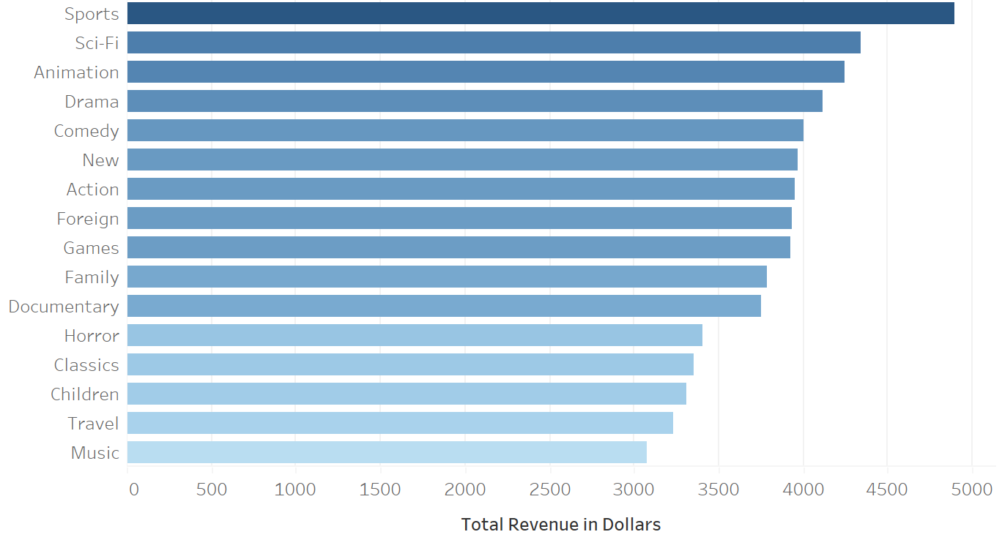
Revenue by Genre
The highest revenue-generating genres are sports, sci-fi and animation
The lowest revenue-generating genres are music, travel and children

Slide 7
Recommendations
Investigate why the least revenue-generating movies are rented for a long time, yet do not make as much money
01
Procure movies from the popular genres which are: sports, sci-fi and animation
02
Increase the marketing budget for areas that have high customer counts/revenue, such as India, China and the United States
03

